Slide 1
Prediction models on diamond price
Zhenming Yang
932784300

Slide 2
Project description
Final project of CS 540
Finished with R language
Combined with crawler and data analysis
Accelerated by parallel programming
Compare four machine learning models
Rshiny used for predictions

Slide 3
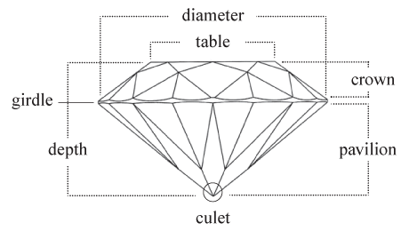
Basic knowledge about diamond dataset
11 properties for one diamond:
Price
Table
Depth
X,Y,Z
Cert
Carat
Clarity
Color
Cut

Slide 4





Basic knowledge about diamond dataset
11 properties for one diamond:
Price
Table
Depth
X,Y,Z
Cert
Carat
Clarity
Color
Cut
Cert

Slide 5
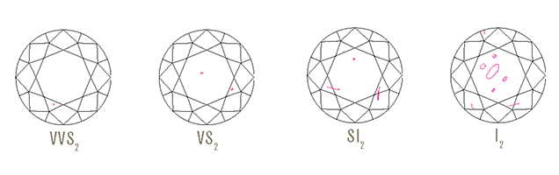
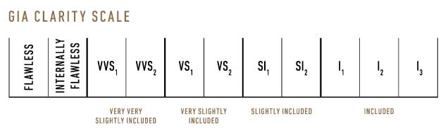
Basic knowledge about diamond dataset
11 properties for one diamond:
Price
Table
Depth
X,Y,Z
Cert
Carat
Clarity
Color
Cut
Clarity
Refers to the absence of these inclusions and blemishes.

Slide 6
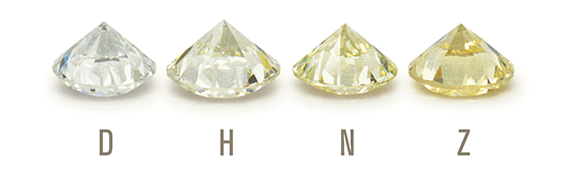
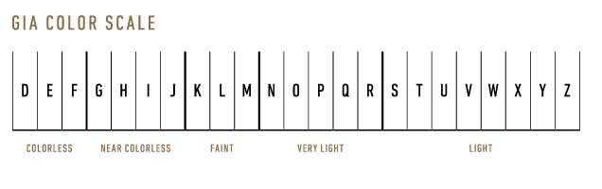
Basic knowledge about diamond dataset
11 properties for one diamond:
Price
Table
Depth
X,Y,Z
Cert
Carat
Clarity
Color
Cut
Color
Is what you cannot see. Diamonds are valued by how closely the approach colorlessness.

Slide 7
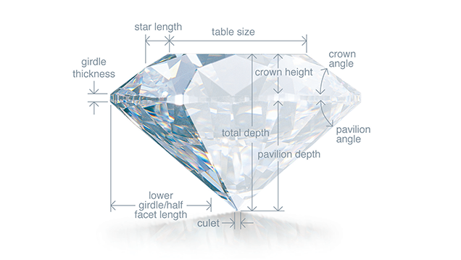
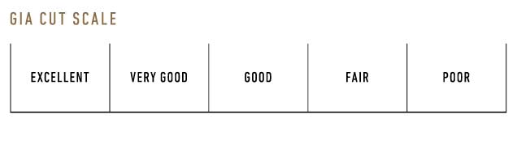
Basic knowledge about diamond dataset
11 properties for one diamond:
Price
Table
Depth
X,Y,Z
Cert
Carat
Clarity
Color
Cut
Cut
Is the factor that fuels a diamonds' fire sparkle and brilliance.

Slide 8
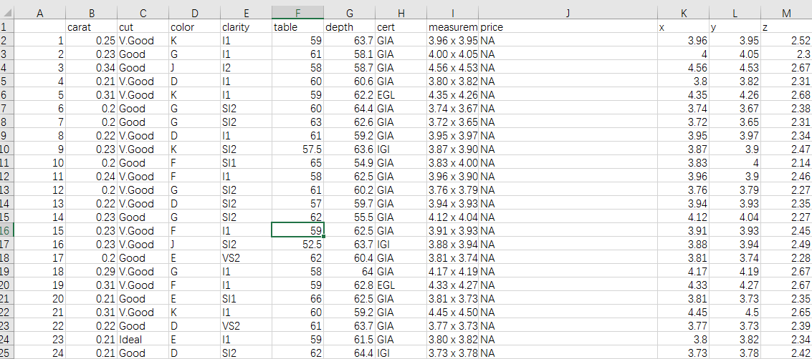
Source of data
All data from diamond search engine
http://www.diamondse.info/diamond-prices.asp
Analysis and collected with R crawler- rverst
More than 500000 round diamonds info collected

Slide 9
Source of data
Separate measurements in to x, y, z.
Omit NA and 0 values.
Shape: Round
Cut: 3 grades ( Good, V.Good, Ideal)
Color: 9 grades (D,E,F,G,H,I,J,K, L)
Clarity 10 (FL,IF,VVS1,VVS2,VS1,VS2,SI1,SI2,I1,I2)
Cert 9 grades( GIA, AGS, EGL,IGI,HRD,EGL USA, EGL INIFI, EGL ISRAEL, Others)

Slide 10
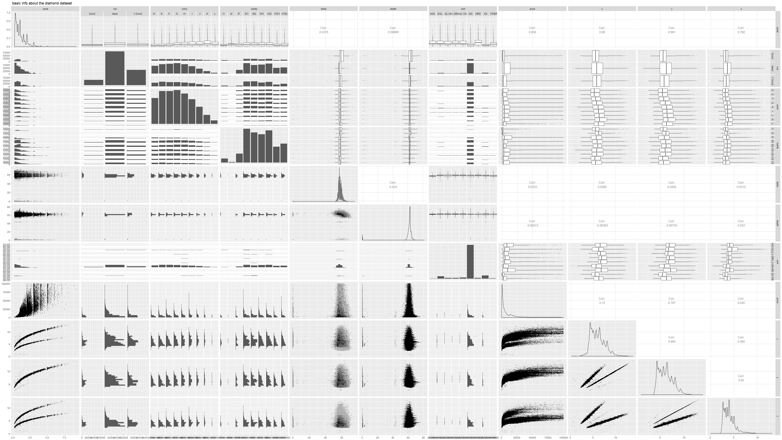
First step: general analysis

Slide 11
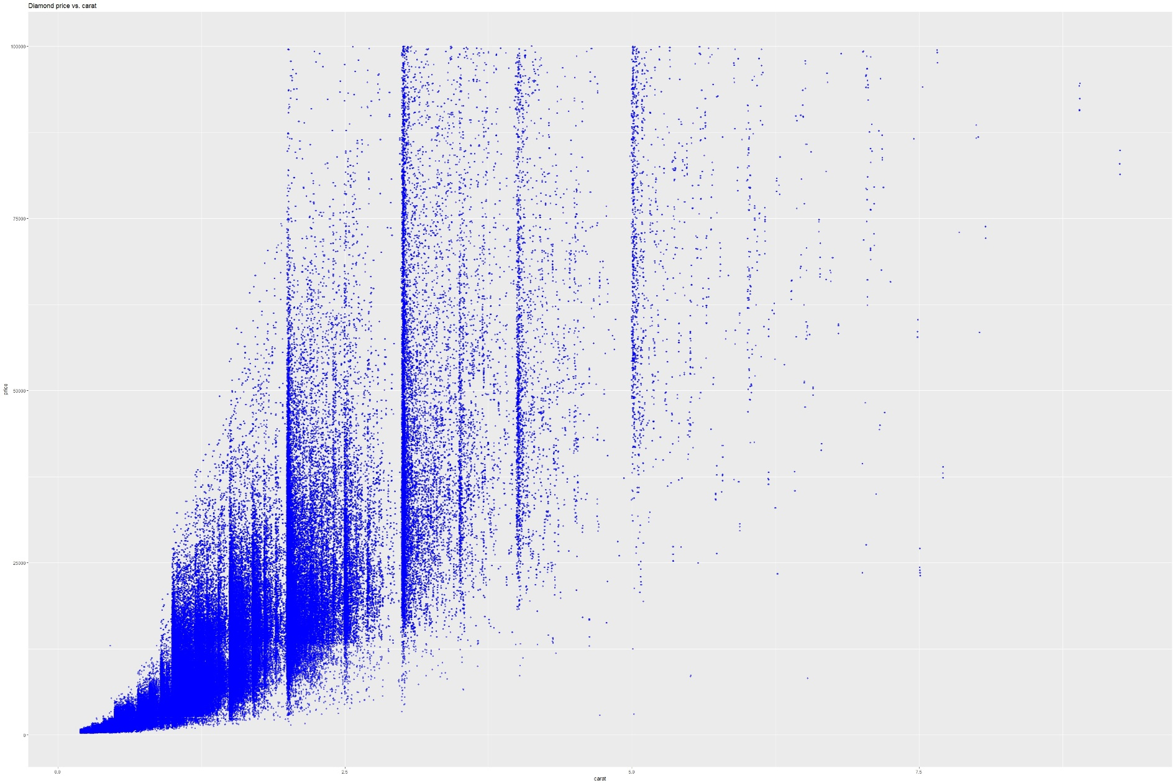
First step: general analysis

Slide 12
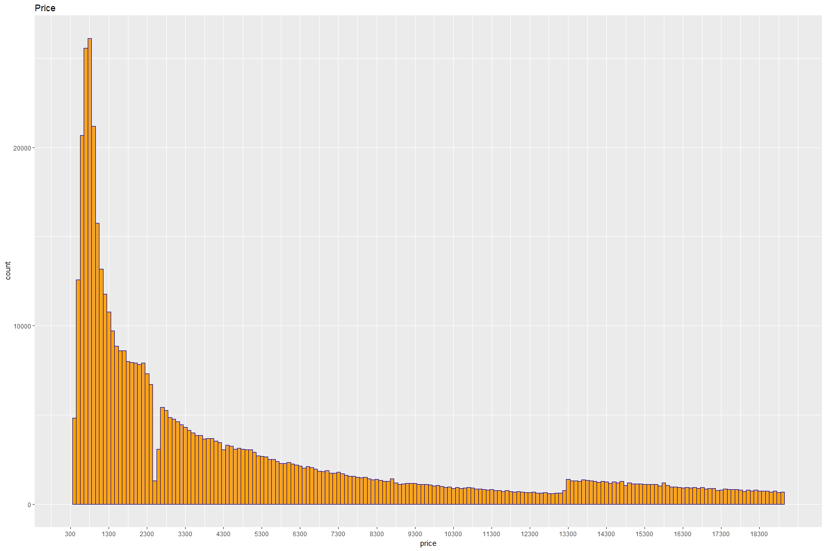
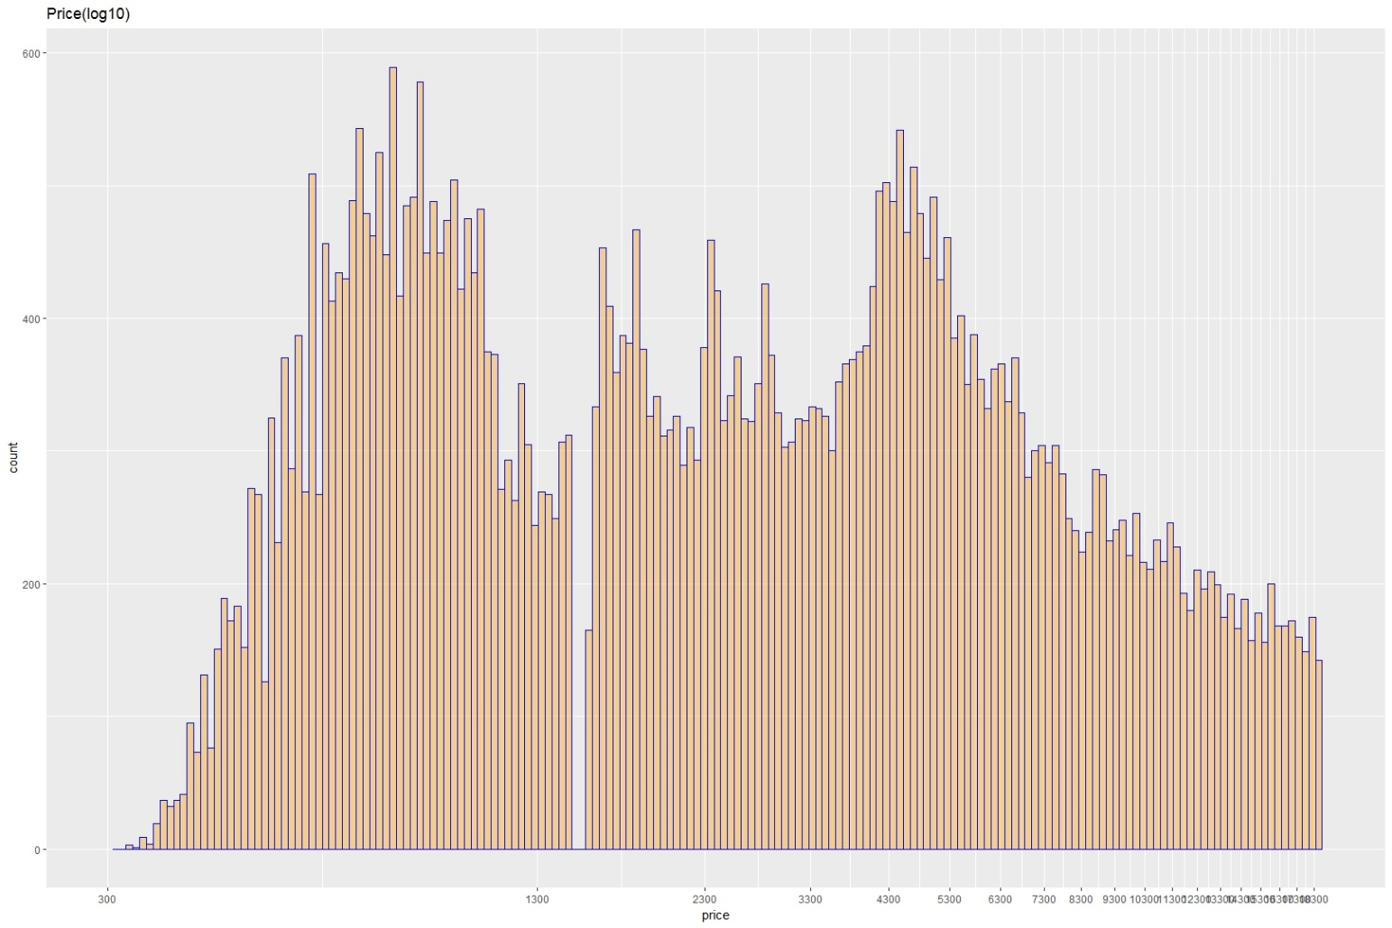
First step: general analysis

Slide 13
First step: general analysis
Log10
In statistic, normal distribution is ideal and balanced is the least requirement
Most of data in real world follow the skewed distribution
One method to transform skewed distribution (Normality transform, Homogeneous transform and Inverse transform etc.)
Let the variance is constant, which volatility is relatively stable

Slide 14
First step: general analysis

Slide 15
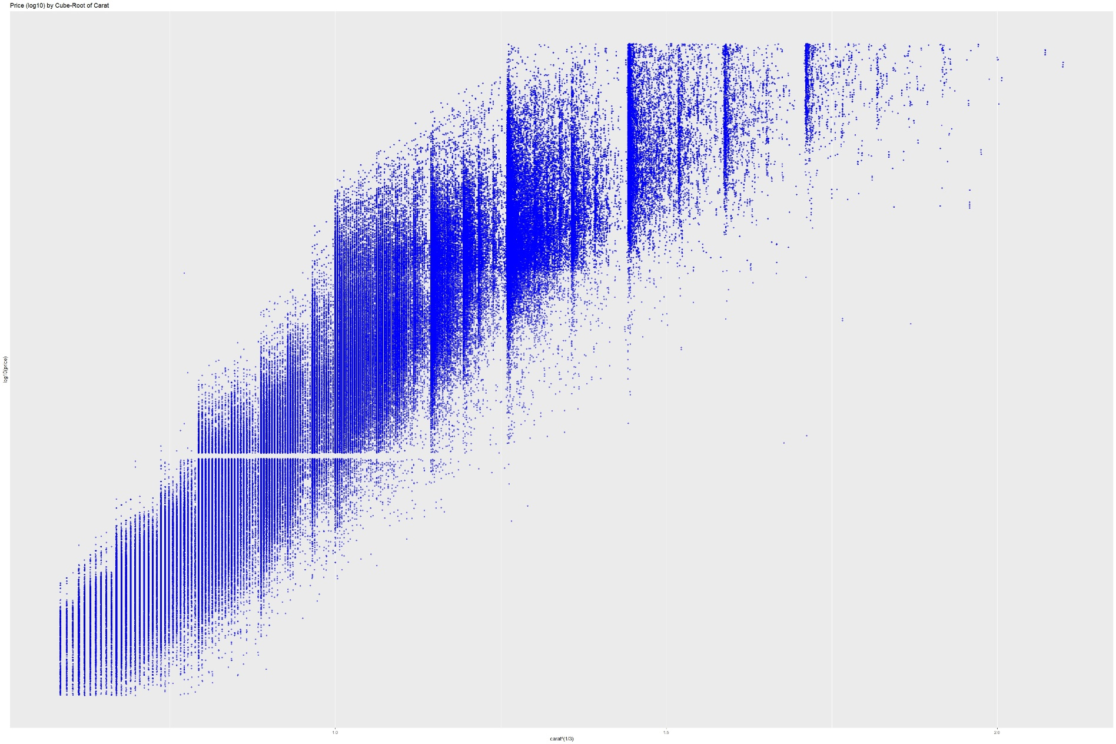
First step: general analysis

Slide 16
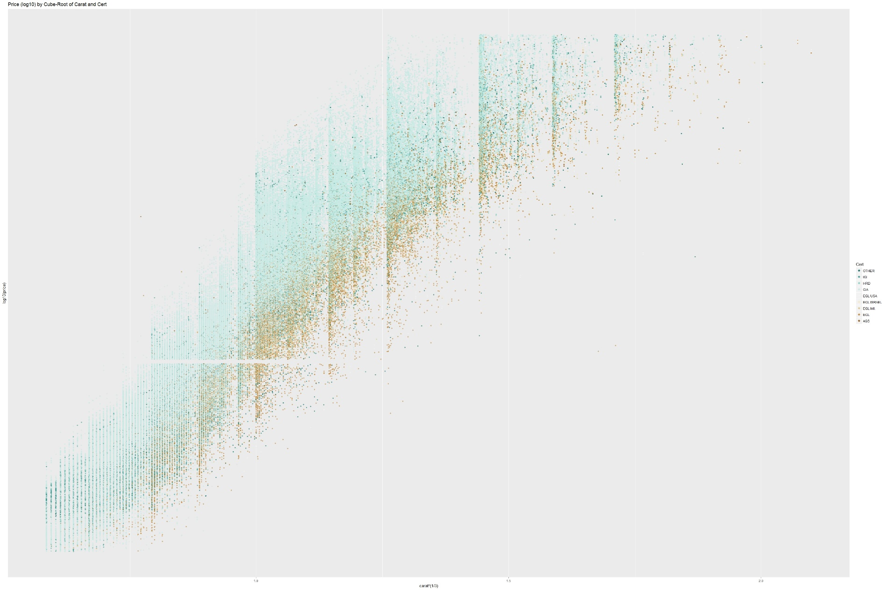
First step: general analysis

Slide 17
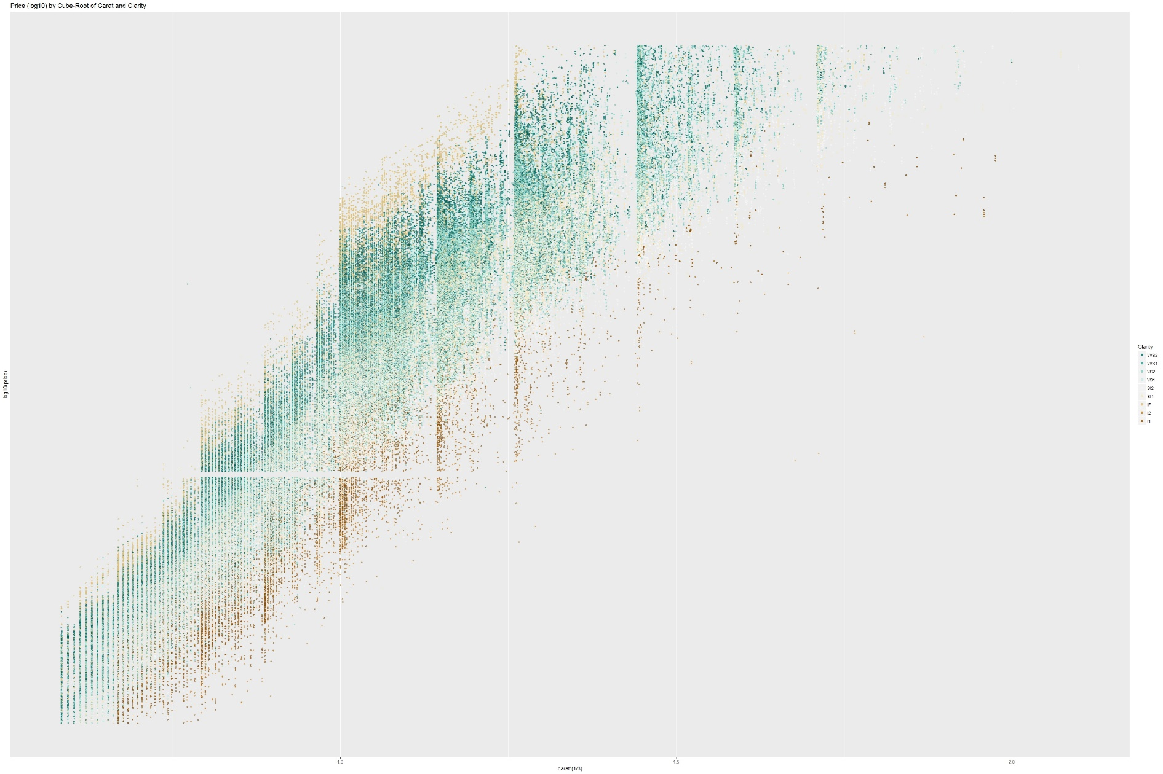
First step: general analysis

Slide 18
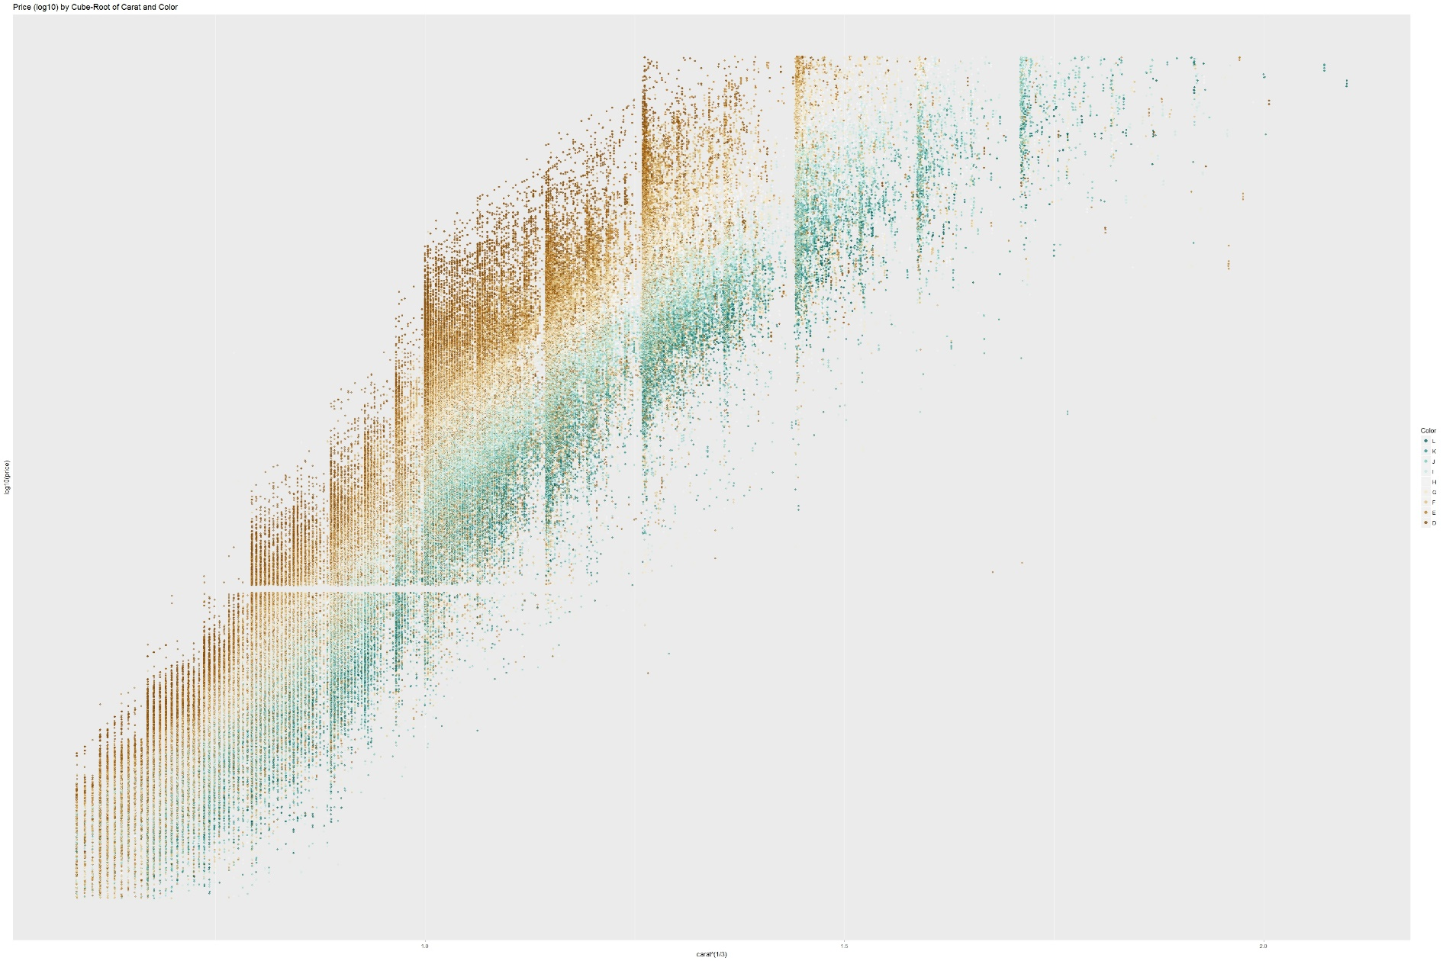
First step: general analysis

Slide 19
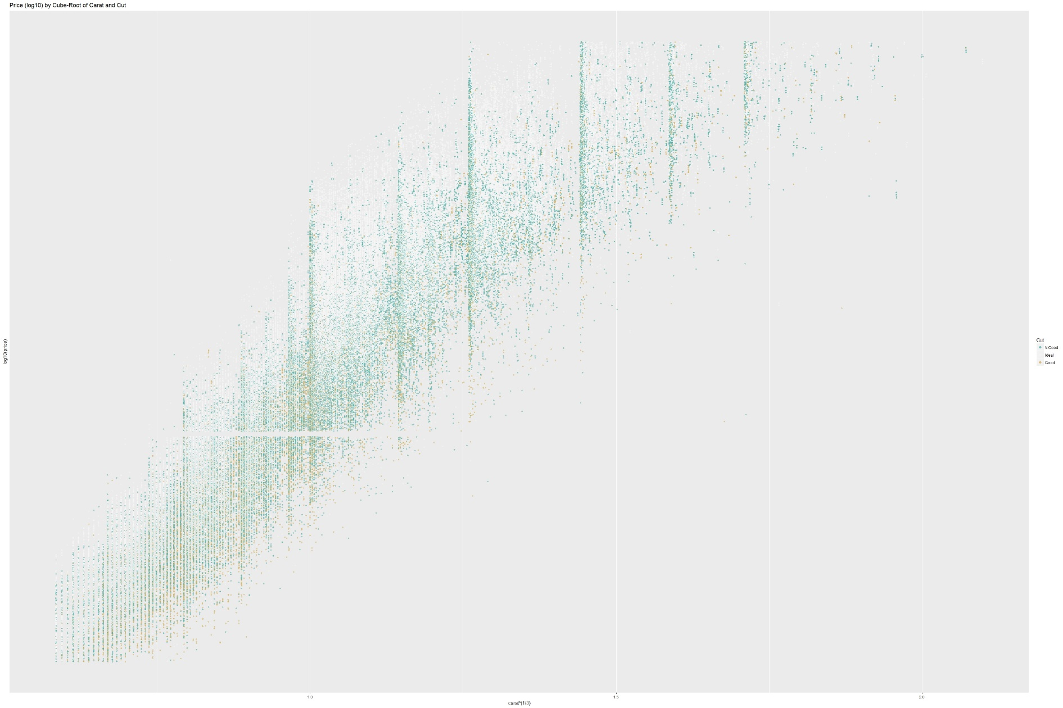
First step: general analysis

Slide 20
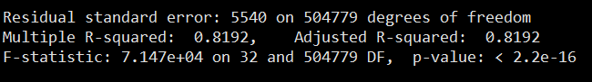
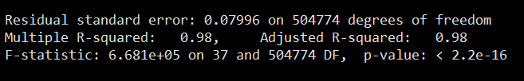
Model 1 : Multilinear regression
Basic model: lm1=lm(price~carat+cut+clarity+color+cert+table+depth+x+y+z, data=train)
Optimized model: lm2=lm(I(log10(price)~I(carat)^(1/3))+carat+cut+clarity+color+cert+table+depth+x*y*z ,data=train)

Slide 21
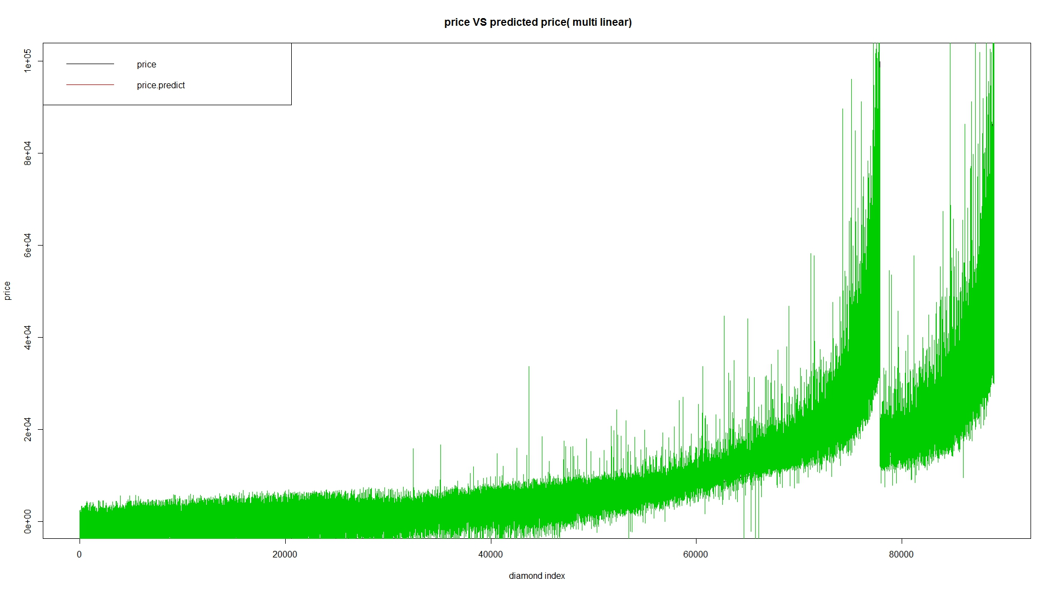
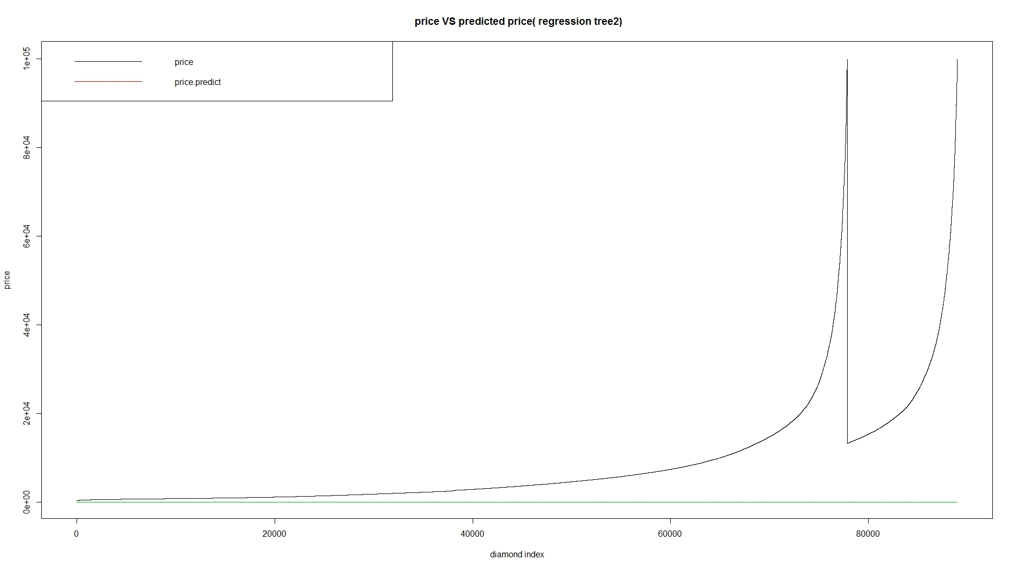
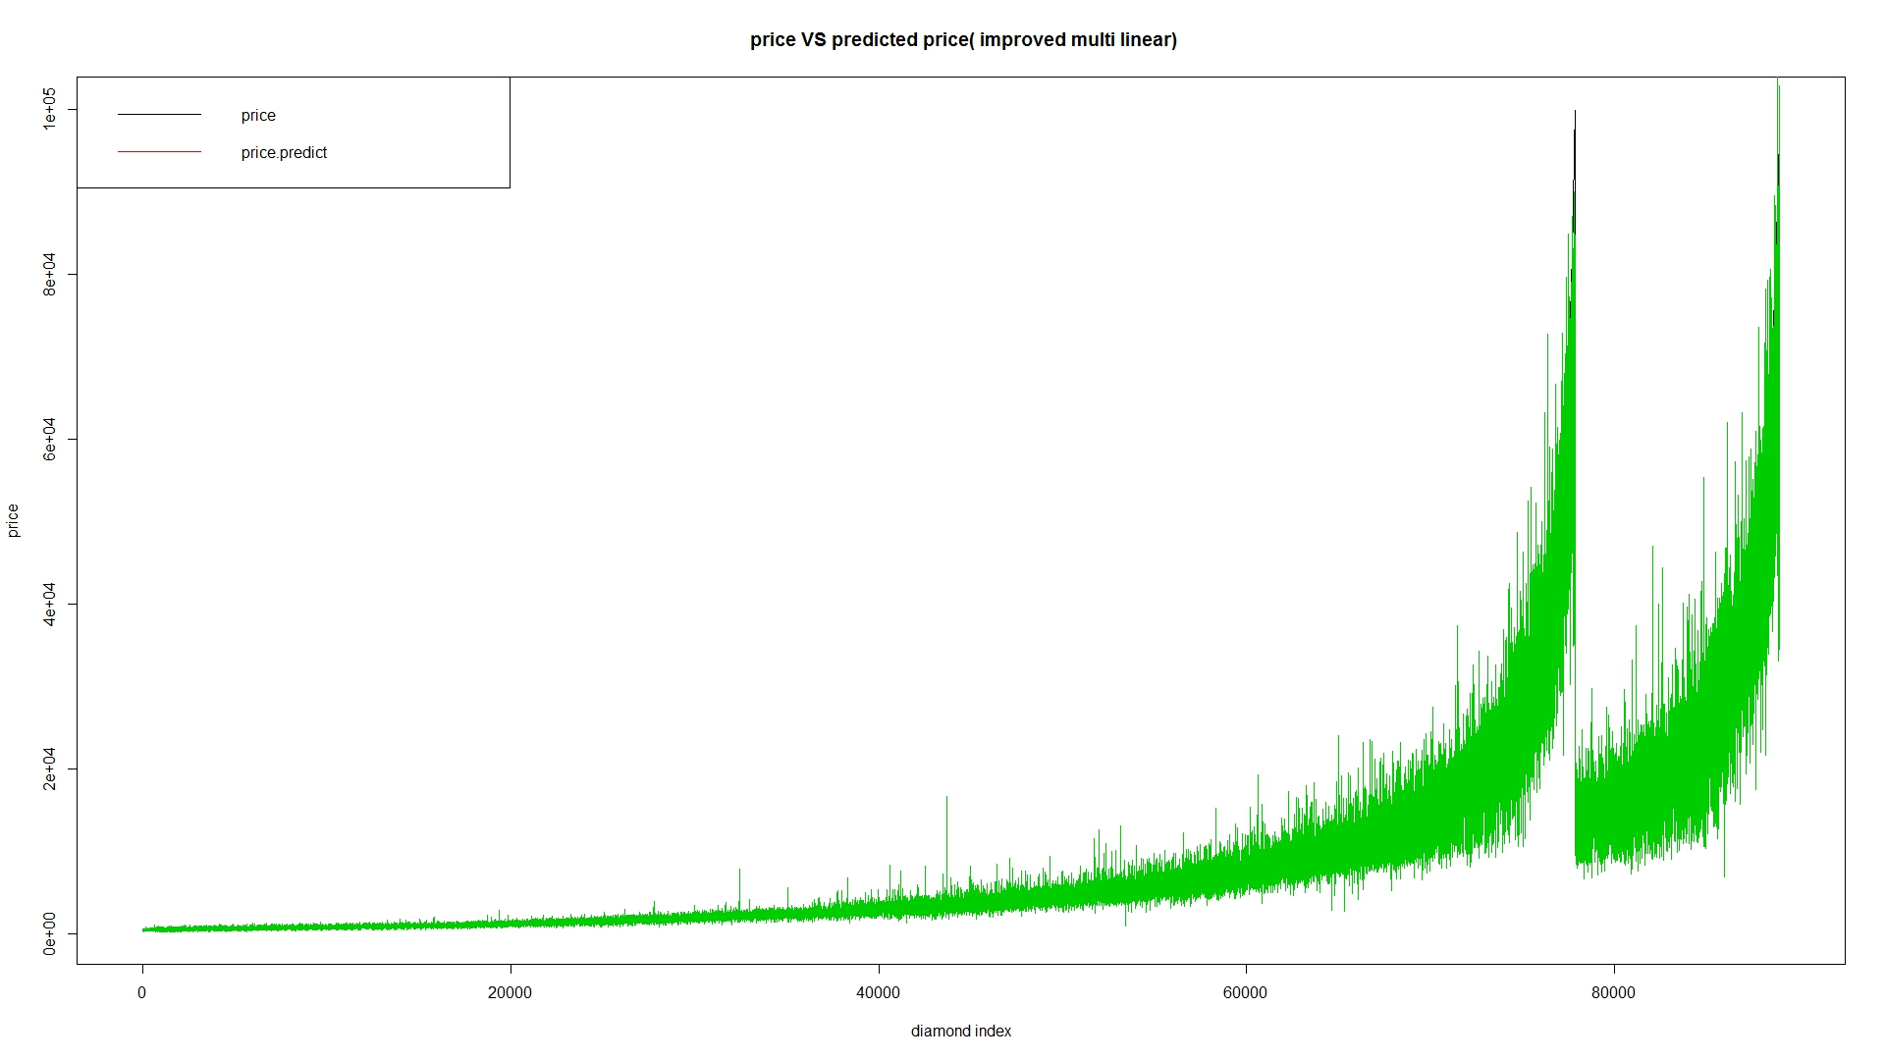
Model 1 : Multilinear regression

Slide 22
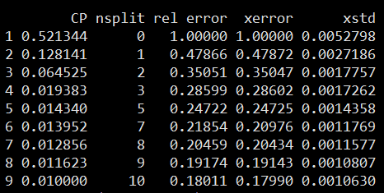
Model 2 : Regression tree
Select CART as basic algorithm to build
Prune with 1-SE standard

Slide 23
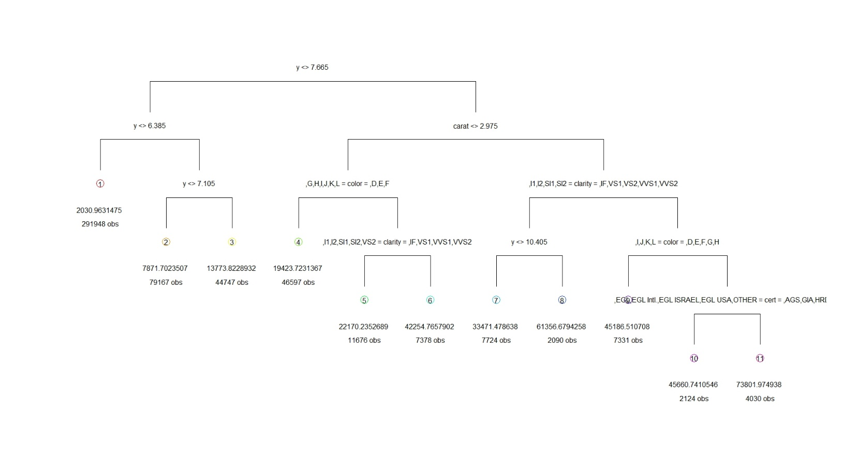
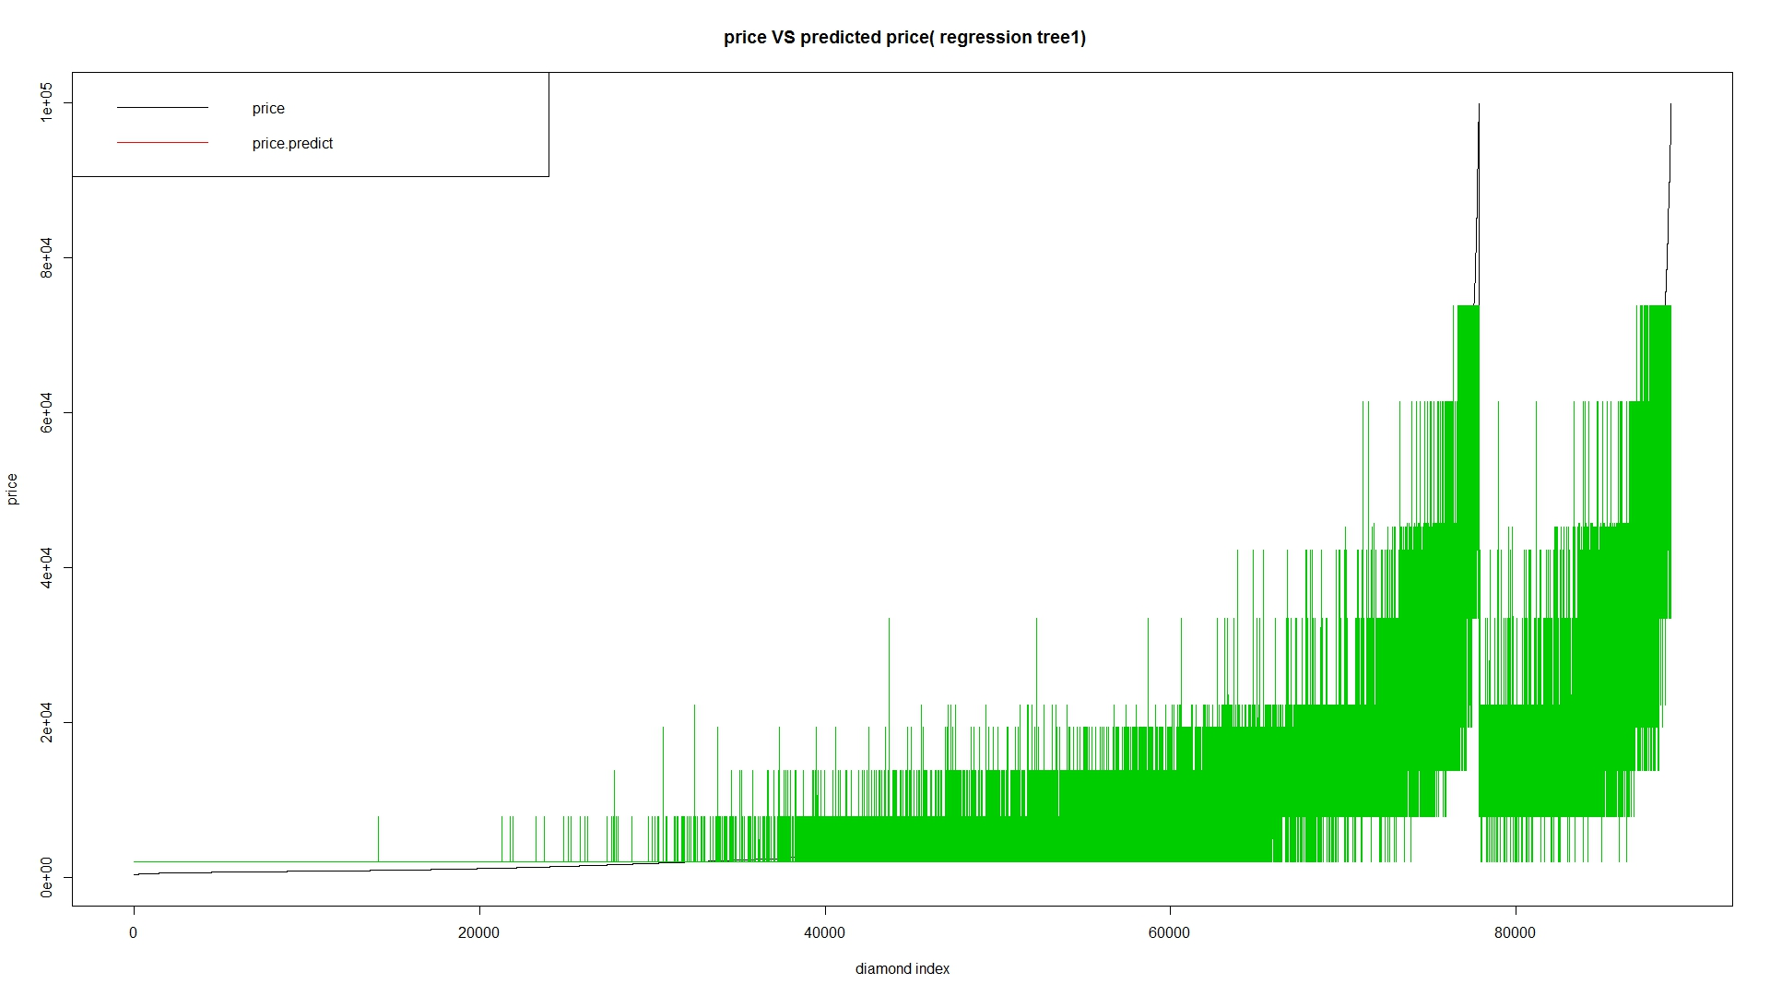
Model 2 : Regression tree

Slide 24
Model 3 : KNN

Slide 25
Model 3 : KNN

Slide 26
Model 4 : Random forest

Slide 27
Model 4 : Random forest
One classifier with multiple regression trees.
Ranger, implemented as in the original Random Forest(Bremian 2001)
Basic parameters:
Num.trees:600
Mtry:3
Num.thread:8
Splitrule: variance
Classification: FALSE

Slide 28
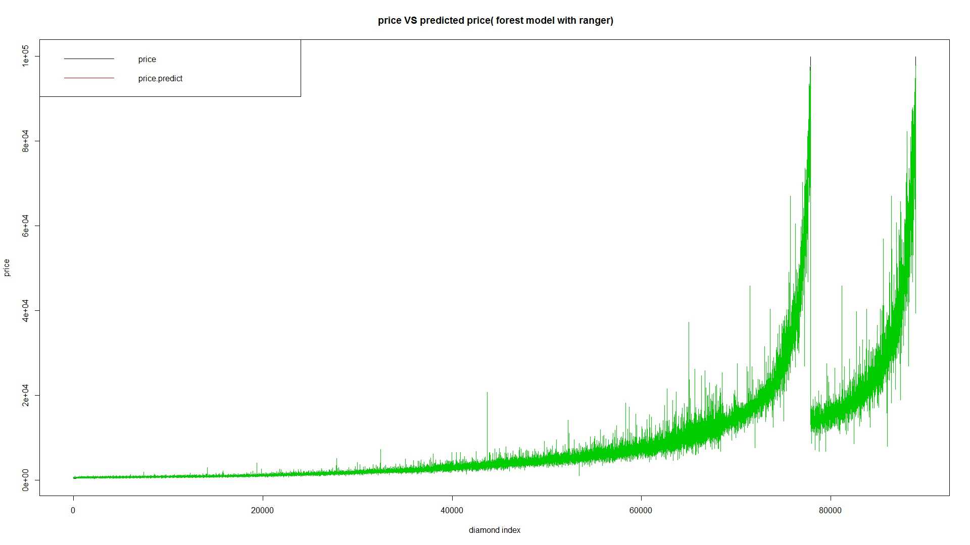
Model 4 : Random forest

Slide 30
Two Content Layout with Table
First bullet point here
Second bullet point here
Third bullet point here
Class | Group A | Group B
Class 1 | 82 | 95
Class 2 | 76 | 88
Class 3 | 84 | 90

Slide 31
Two Content Layout with SmartArt
Group A
Task 1
Task 2
Group B
Task 1
Task 2
Group C
Task 1
First bullet point here
Second bullet point here
Third bullet point here

Slide 32
Add a Slide Title - 2

Slide 33
Add a Slide Title - 3

Slide 35
Add a Slide Title - 4

Slide 36
Add a Slide Title - 5

Slide 37
Title Layout
Subtitle

